Slide 1

FORK BOMB ATTACK
Presented by-
Girish Baldota and Mandar Desai

Slide 2
Introduction
Fork Bomb History
Pre-requirement for the fork bomb

Slide 3
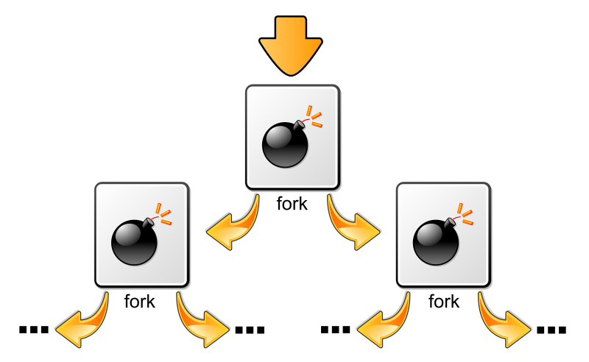
What is Fork Bomb
Denial of Service attack
Fork System Call <pid_t fork(void)>
Formation of Fork Bomb

Slide 4
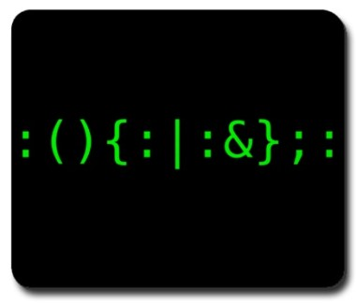
Implementation and behaviour of fork bomb attack
#include <unistd.h>
int main(void)
{
for(;;)
fork();
return 0;
}

Slide 5

How to Prevent the attack
Limiting user processes - To limit user process just add user name or group or all users to /etc/security/limits.conf file and impose process limitations.
Understanding /etc/security/limits.conf file - <domain> <type><item><value>
The root for opening Configuration file - # vi /etc/security/limits.conf
E.g.- vivek hard nproc 300 @student hard nproc 50 @faculty soft nproc 100

Slide 6

Conclusion

Slide 7


Thank You
Questions
and
Answer. . . . .

